Slide 1
Embedded systems
DR/ Ahmed Zakaria
TA/Ahmed Tarek
TA/Mariem Faried
TA/Ahmed Abdel Latief

Slide 2
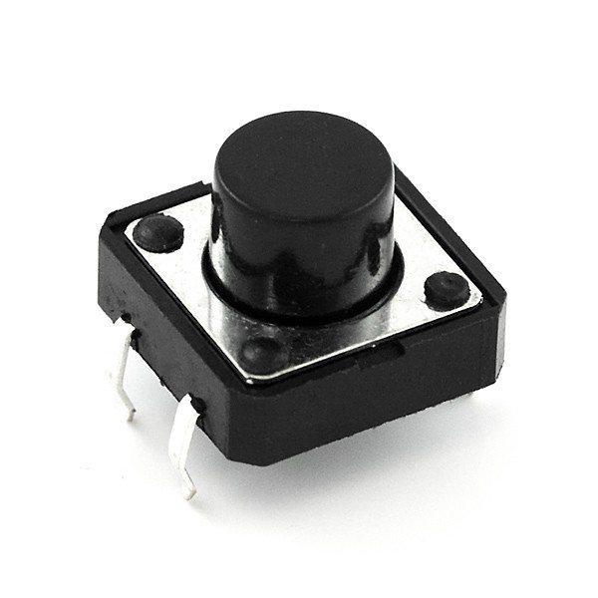
Push buttons
Push buttons come in different shapes and sizes. But the internal structure and working principle are the same for most push buttons.
Push buttons usually have four pins. But these pins are connected internally in pairs. So actually you have two connections. When you press the button these two terminals will connect together. And when you release the button these terminals will disconnect.

Slide 3
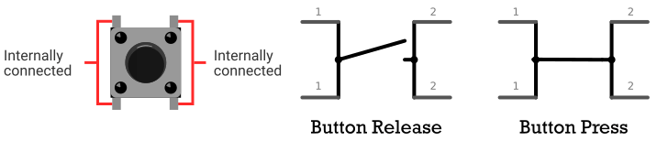
How Push btn work

Slide 4
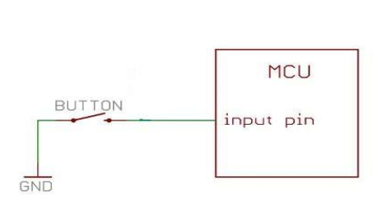
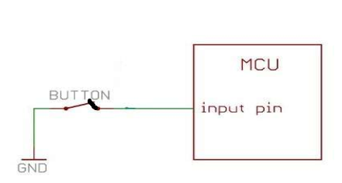
Switches
What is the difference between these 2 switched and what is the pin value
IF Switch Closed and Opened

Slide 5
Floating Pin
A signal is said to be “floating” when its state is indeterminate, meaning that it is neither connected to VCC or to ground. The signal's voltage will “float” to match the residual voltage. The term “floating” is often used colloquially to describe a pin which is in the high-impedance state.

Slide 6
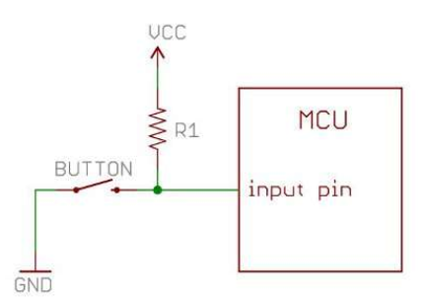
How to Solve it ?
Pull up Resistor:
Pull-ups are resistors that connect a signal to VCC. Pull-ups are used to set a default state when the signal is floating.
Recall that when an input pin is in high-impedance mode and not driven by external sources, it is floating at a residual voltage level. Pull-up resistors prevent the pin from floating by forcing the signal to VCC when it is not being actively driven. When another source drives the signal low (connects to ground), the pull-up is overridden and the input pin will read a ‘0’.
Sw/ Closed p=GND
SW opened P=VCC

Slide 7
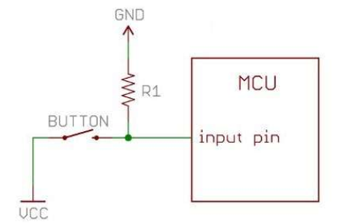
Pull Down Resistance:
Pull-downs are resistors that connect a signal to ground. Pull-downs are used to set a default state when the signal is floating. When another source drives the signal high (connects to VCC), the pull-down is overridden and the input pin will read a ‘1’.
Many microcontrollers supply internal pull-down configuration options. Sometimes, a specific pull-down resistor value is required which necessitates using an external pull-down instead of a chip’s internal pull-down.
Sw Closed P=VCC
Sw opened P=GND

Slide 8
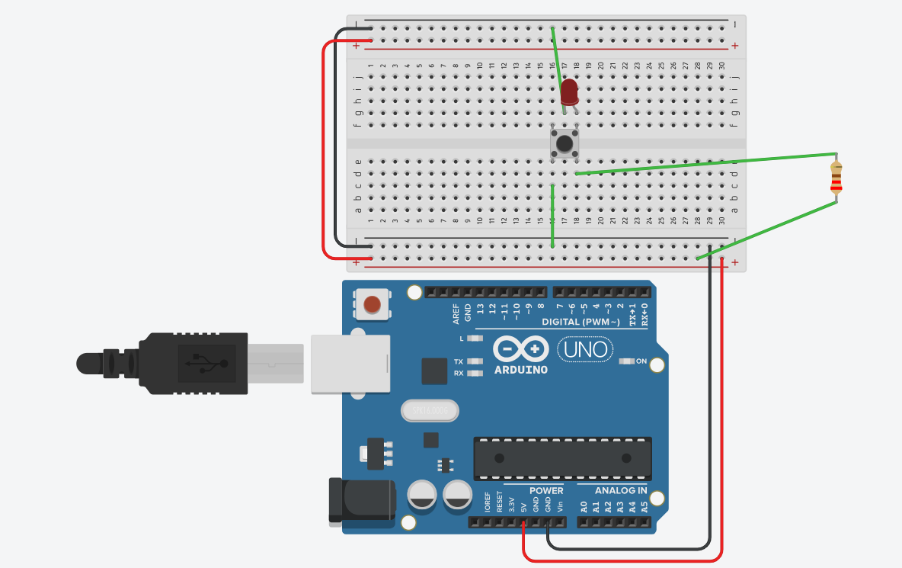

Slide 9
Task 1
Cerate a Circuit for Button state change detection using a led and button : when ever you press the button the Current state of led changes (On-Off)

Slide 10
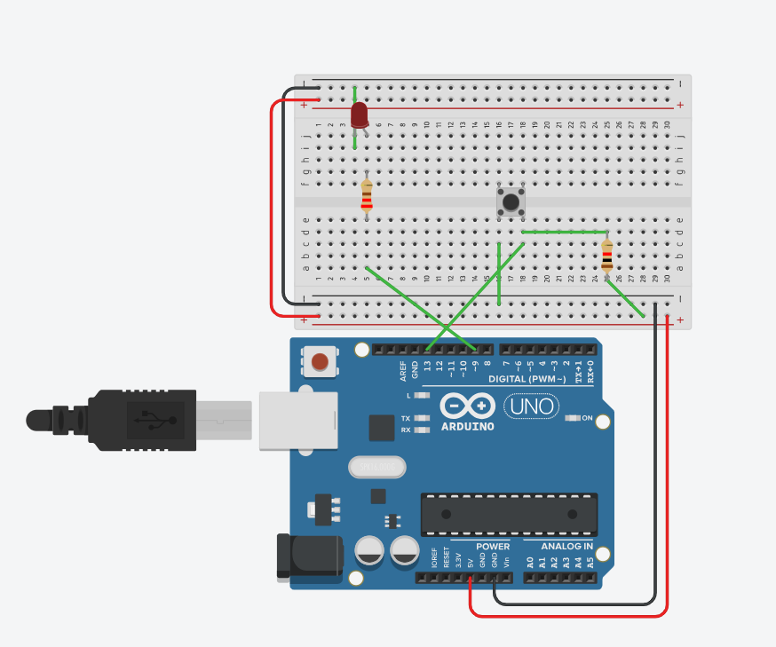
Diagram

Slide 11
Diagram+Code
const int buttonPin = 13;
const int ledPin = 9;
void setup() {
pinMode(ledPin, OUTPUT);
pinMode(buttonPin, INPUT);
}
void loop() {
int currentState = digitalRead(buttonPin);
if (currentState == LOW) {
digitalWrite(ledPin, HIGH);
}
else if (currentState == HIGH) {
digitalWrite(ledPin, LOW);
}
delay(50);
}

Slide 12
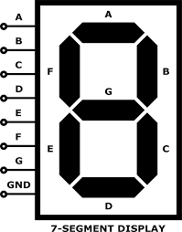
7-segment Display
An LED or Light Emitting Diode, is a solid state optical pn-junction diode which emits light energy in the form of photons

Slide 13
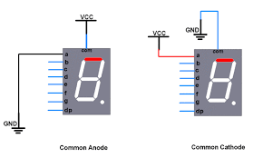

Slide 14
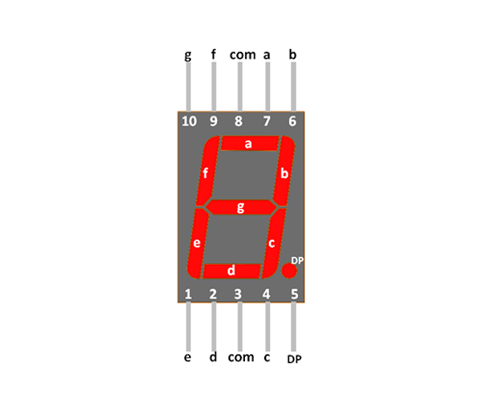

Slide 15
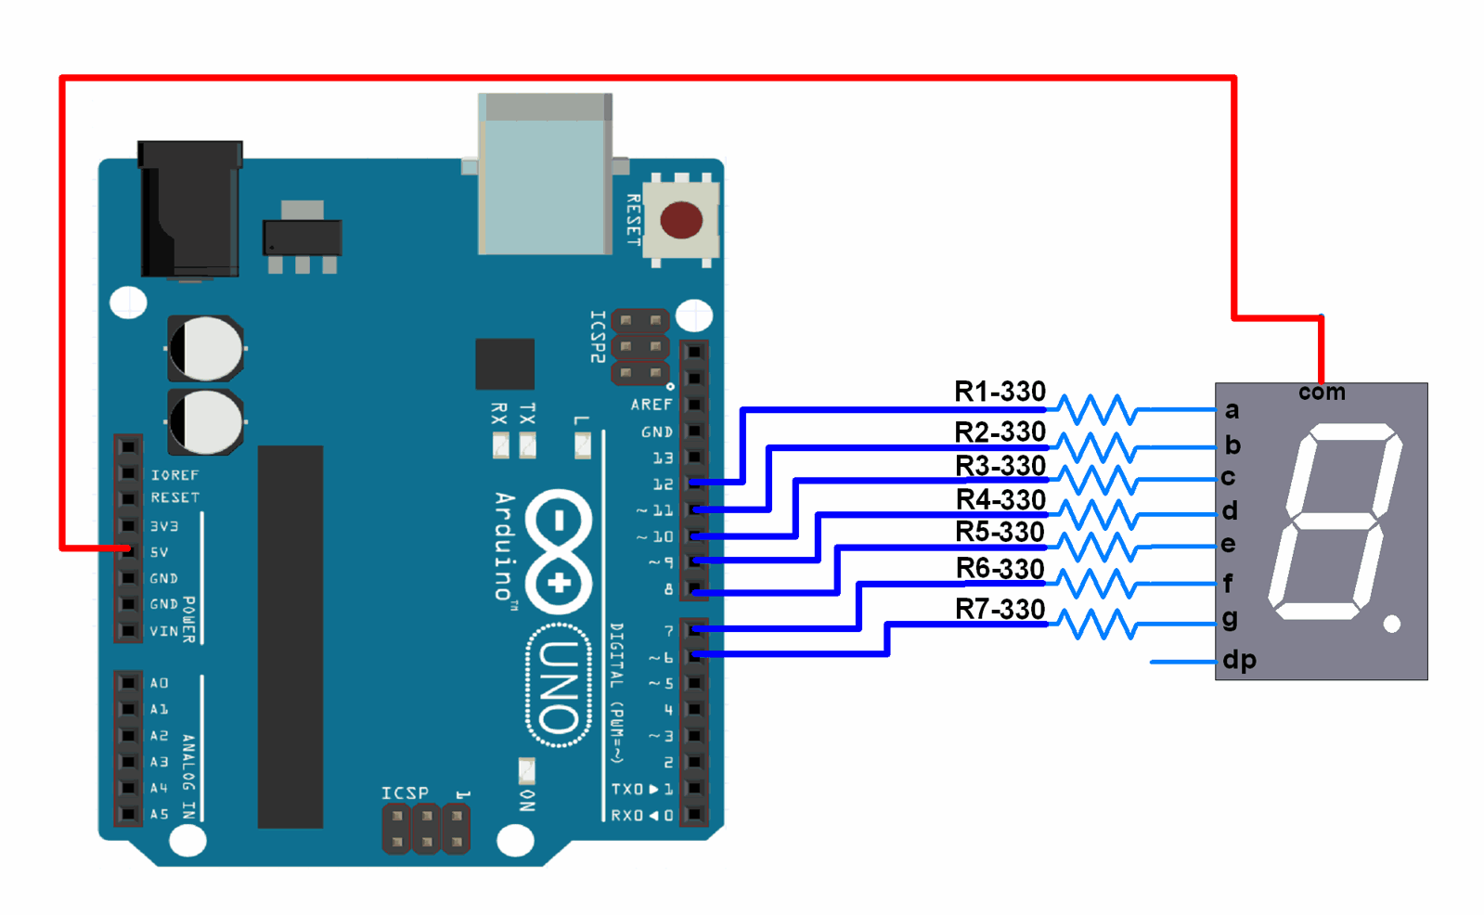
Interfacing 7-segment

Slide 16
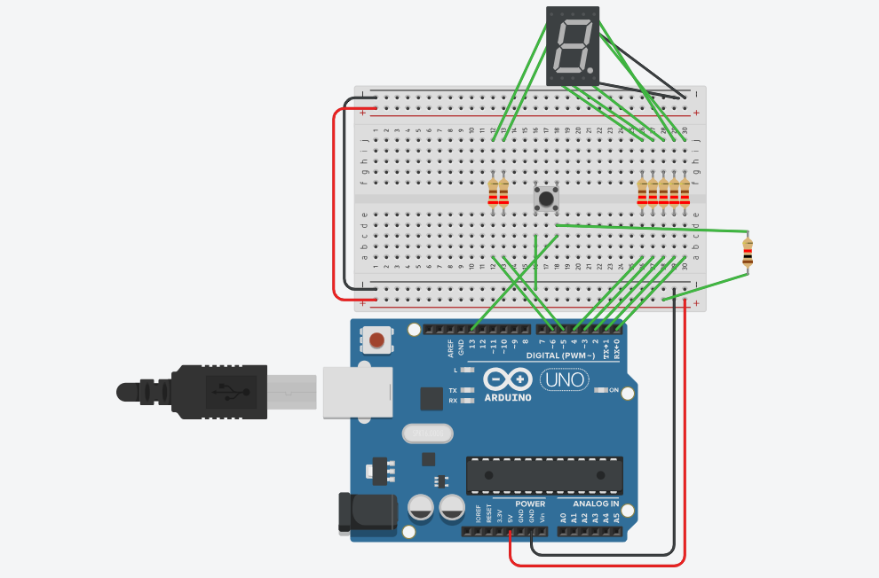
Practice
USING 7-SEGMENT write code with 7-segment to display numbers from 0 to 9 and repeat the process using a button

